Slide 1
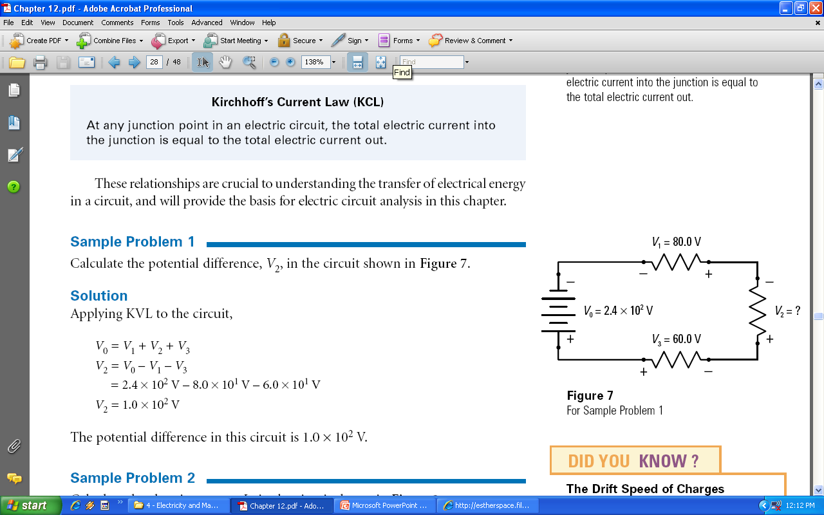
Circuit Diagrams - Symbols
What do the symbols in this circuit diagram mean?

Slide 2
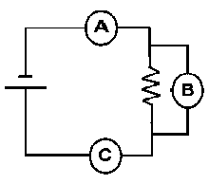
Circuit Diagrams - Meters
What type of meters (Ammeter or Voltmeter) are connected at positions “B”, “C”, and “D”?
B
C
D

Slide 3
Circuit Diagrams - Meters
What type of meters (Ammeter or Voltmeter) are connected at positions “B”, “C”, and “D”?
A
V
A

Slide 4
Circuit Diagrams - Measurements
Current
Symbol is "I"
Measured in Amps (A)
Potential Difference (Voltage)
Symbol is "V"
Measured in Volts (V)
Resistance
Symbol is "R"
Measured in Ohms (Ω)

Slide 5
Electricity – Ohm’s Law
V = I R
I = V / R
R = V / I

Slide 6
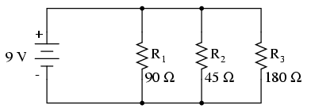
Circuit Diagrams - Types
What are the two types of circuits?
Series
Parallel
20 Ω
12 V
40 Ω
60 Ω

Slide 7
Series Circuits
What do we know about series circuits?
About the Number of Paths?
About Voltage?
About Current?
About Resistance?
20 Ω
12 V
40 Ω
60 Ω

Slide 8
Series Circuits
Find the Equivalent Resistance for this circuit.
20 Ω
12 V
40 Ω
60 Ω

Slide 9
Series Circuits
Solve this circuit (Find I and V through each R).
20 Ω
12 V
40 Ω
60 Ω

Slide 10
Parallel Circuits
What do we know about parallel circuits?
About the Number of Paths?
About Voltage?
About Current?
About Resistance?

Slide 11
Parallel Circuits
Find the Equivalent Resistance for this circuit.

Slide 12
Parallel Circuits
Solve this circuit (Find I and V through each R).

Slide 14
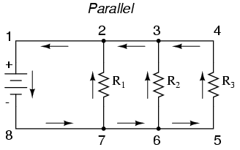

Slide 15
Electricity – Ohm’s Law
V = I R
I = V / R
R = V / I

Slide 16
Series Circuits – Equivalent Resistance
Calculate the Equivalent Resistance of the circuit
Calculate the current in the circuit
Calculate the voltage drop across each resistor
20 Ω
12 V
40 Ω
60 Ω

Slide 17
Series Circuits – Ohm’s Law
In the circuit shown below, what is the potential drop V₂ across resistor #2?
In the circuit shown above, what is the resistance of each of the resistors if the current through the circuit is 2.0 A?

Slide 18
Parallel Circuits
Determine the potential difference across each resistor
Use Ohm’s law to calculate the current through each resistor
Determine the total current out of the battery

Slide 19
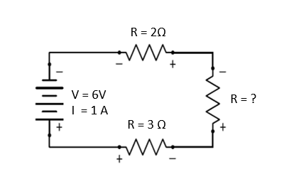
Electricity Practice #1
Calculate the missing resistor value

Slide 20
Electricity Practice #2
Calculate the potential difference (Voltage) of the battery
Calculate the current provided by the battery
V = ?
I = ?
R = 3 Ω
I = ?
V = ?
R = 3 Ω
I = ?
V = ?
R = 6 Ω
I = 2 A
V = ?

